Slide 1
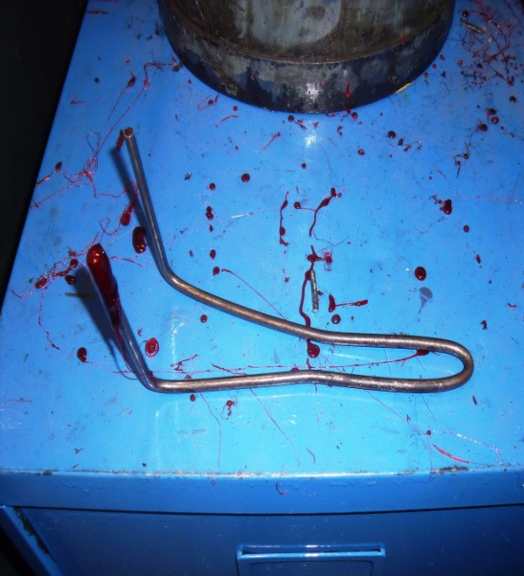
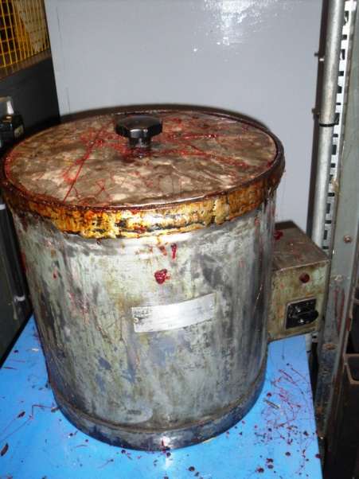

HS&E INCIDENT BULLETIN |  | 2nd Quarter 2012
Type of Incident: | Burn
Summary:
The IP was preparing the hot Crowsel for dipping components for protection, he was checking the pot with the tool when a lump of un-molten plastic stuck to it which he went to brush off resulting in his fingers contacting the hot molten solution on the tool. He is unsure whether his fingers went into the hot vat as well. The hot molten plastic stuck to his hands as he was not wearing gloves. He shock his hand and splashes of hot plastic hit other parts of his body.
Root Causes: | Actions Taken Thus Far: Next Steps
People -Failure to use proper PPE Procedures -Incomplete procedure/instructions Equipment -Lack of labeling or signs or other form of warning -Proper equipment/tools not available | SOP now established & all operators re-trained Suitable heat resistant gloves implemented & new dipping tool implemented. Beware hot sign fitted to dip tank IP undertaken awareness presentations to others to reminded people to always wear gloves when conducting hazardous operations

